Slide 1
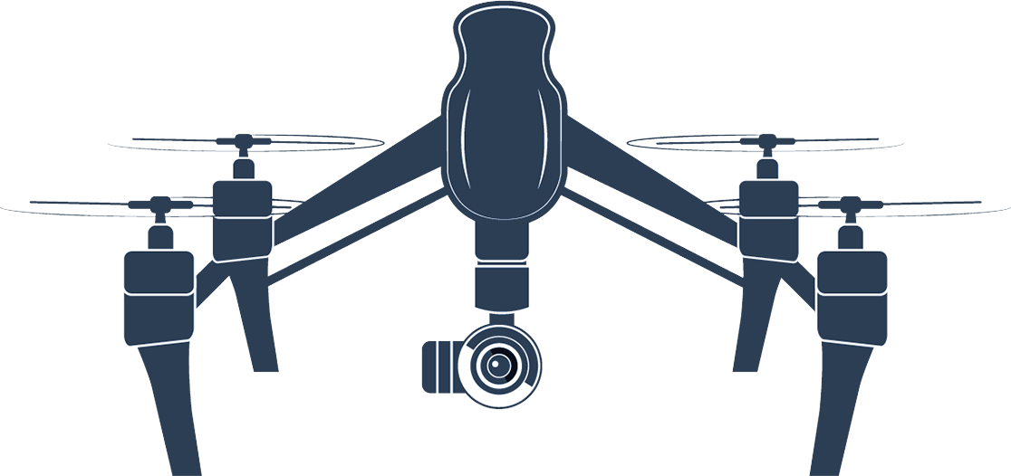


2023
Consensus-based
Communication-aware
Formation Control
Sang Xing (PSU)
Samuel Peccoud (CSU)
ERAU NSF REU

Slide 2

Formation Control
Significance
Project Goal
Utilize communication-aware formation control model to achieve the following 4 tasks in a dynamic multi-agent system.
The first three problems enhance the mobility of the multi-agent system. By effectively addressing challenges such as the presence of obstacles, the system becomes more adaptable and resilient. Specifically, the investigation of a jamming area, where communication between agents is impaired. From this research, we aim to adopt a flexible formation control model that adapts to complex and changing environments.
Problem Formulation
With one agent fixed.
With one agent joining or leaving.
Breaking into two formations
Operation in the presence of a jamming area

Slide 3
Formation Control
Purpose Statement
The purpose of research study is to enhance the mobility of multi-agent systems by adopting a flexible formation control model that adapts to complex and changing environments.

Slide 4

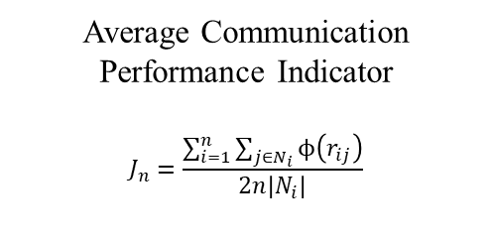
Simulation (Tentative)
Average Communication Performance Indicator
$$J_{n}=\frac{\sum_{i=1}^{n}{\sum_{j∈N_{i}}{ϕ\left(r_{ij}\right)}}}{2n\left|N_{i}\right|}$$
0.8
0.6
Jamming Area
0.4
B. Duan, D. Yin, Y. Cong, H. Zhou, X. Xiang and L. Shen, "Anti-Jamming Path Planning for Unmanned Aerial Vehicles with Imperfect Jammer Information," 2018 IEEE International Conference on Robotics and Biomimetics (ROBIO), Kuala Lumpur, Malaysia, 2018, pp. 729-735, doi: 10.1109/ROBIO.2018.8665238.
NS-3 Discrete Even Network Simulator: https://www.nsnam.org/

Slide 5
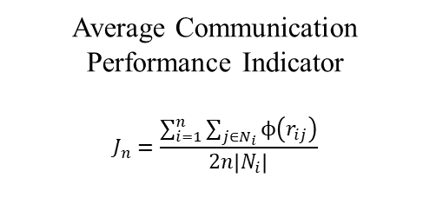
Problem Formulation
Average Communication Performance Indicator
$$J_{n}=\frac{\sum_{i=1}^{n}{\sum_{j∈N_{i}}{ϕ\left(r_{ij}\right)}}}{2n\left|N_{i}\right|}$$
1. Path Planning Algorithm: Undetermined
2. The use of Distributed Estimation Algorithm for global features could be used to reach consensus.
(Splitting Formation / Leaving one behind)
0.8
0.6
Jamming Area
0.4
3. Rejoin the formation once communication threshold is met. (Add/Remove Agents)
4. Initial conditions of the multi-agent system:
Fly in? (requires jamming area detection?)
Within the jamming area?

